Slide 1

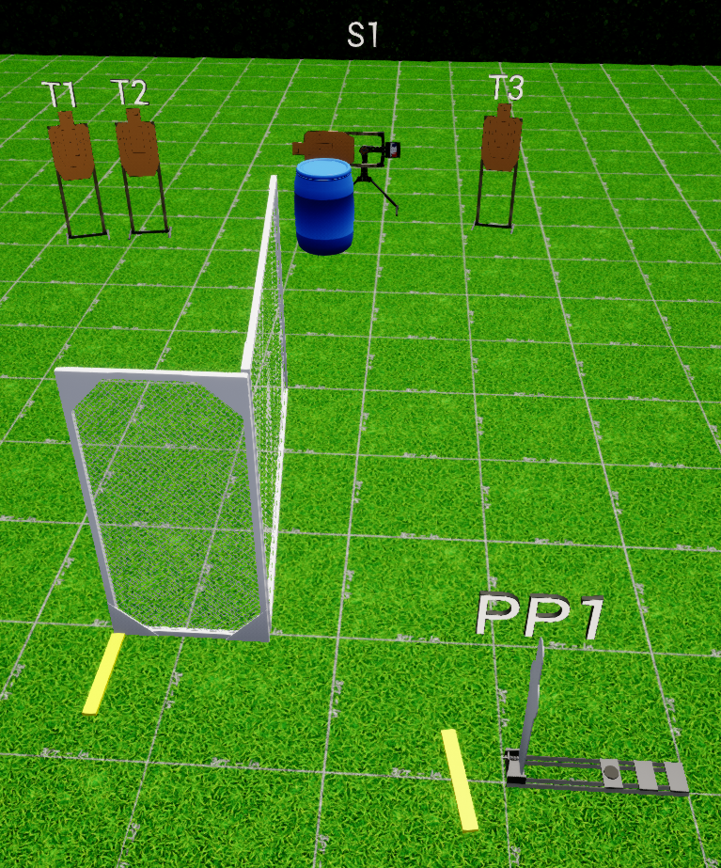
 | Interlake Sporting Association Action Bay, B Stage: Mama, I Punched A Midget Course Designer: Marcel Englmaier
START POSITION: Toes touching starting fault line. Handgun: Loaded and holstered, wrists below belt. PCC: Stock on belt, muzzle pointed downrange. |  | STRINGS: 1 SCORING: Unlimited ROUND COUNT: 4 START-STOP: Audible - Last shot
STAGE PROCEDURE: At the start signal, knock over popper, then engage T3 and Swinger 1. Then engage all remaining targets from P2. Reload required between first and last shot
P1
Start

